Slide 1

You are Not Using Entity Framework Core Migrations Right
Chris Woodruff

Slide 2

Chris Woodruff
Twitter - @cwoodruff
Linkedin - https://www.linkedin.com/in/chriswoodruff/
GitHub Repo for Demos and Slides
https://github.com/cwoodruff/EFCore_Migrations_The_Right_Way

Slide 3


Slide 4
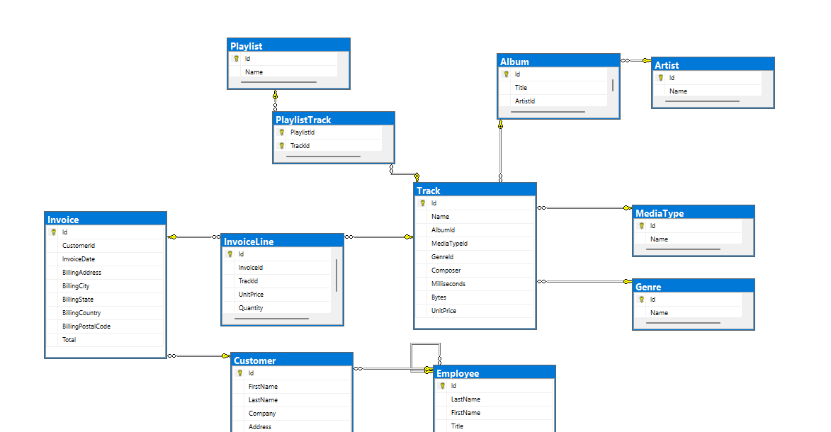

Slide 5
Agenda
Indexes
Relationships
Tables

Slide 6
How to create Migrations
EF Core Migrations
Annotations
Fluent

Slide 7

Tables

Slide 8

Relationships/Associations

Slide 9

Indexes

Slide 10


Slide 11
Resources
Chris Woodruff
Twitter - @cwoodruff
Linkedin - https://www.linkedin.com/in/chriswoodruff/
GitHub Repo for Demos and Slides
https://github.com/cwoodruff/EFCore_Migrations_The_Right_Way
More information on Entity Framework Core and .NET
https://devblogs.microsoft.com/dotnet/

